Slide 1
Chapter six
Core Web Technologies and Management

Slide 2
Chapter outline
Server Side Resource Management
Thread Pool
Server Clustering
Horizontal Clustering
Vertical Clustering

Slide 3
Server Resource Management

Slide 4
Server Resource Problems
EIS usually have to handle plenty of concurrent user requests.
Each request may generate several tasks for the system to process.
However, server has limited resources (CPU, memory, disk space, etc.).
The processes of creating and destroying objects (thread, database connection, collect garbage, etc.) are having impact to the overall performance.
As a result, system with lack of resources will frustrate the users. In the worst case, system will eventually crash down and loss the online transactions.
This low quality services may end-up losing customers.
Therefore, resource management is a critical point to determine the success or failure of the system.

Slide 5
Application Server Management
Many resource areas can be managed in application servers.
CPU, memory, hard-disk, database connection, network, multiple software instances, pooling, queuing, distributing, etc.
They can be configured through XML filesi n modern application server software.
The following books help you to understand the detail on configuring and managing the application servers:
O’Reilly –Tomcat: The Definitive Guide, 2ndedition
Packt–Apache Tomcat 7 Essentials
Wiley –Professional Apache Tomcat 6
Etc.

Slide 6
Server Configuration Files
/Tomcat/conf/server.xml
Control the entire web container
http://tomcat.apache.org/tomcat-9.0-doc/config/server.html
/Tomcat/conf/context.xml
Control a single web application
http://tomcat.apache.org/tomcat-9.0-doc/config/context.html
/Tomcat/bin/catalina.bat or /Tomcat/bin/catalina.sh
Control the environment variables
https://tomcat.apache.org/tomcat-9.0-doc/funcspecs/index.html
/Tomcat/conf/logging.properties
Control the log files
http://tomcat.apache.org/tomcat-9.0-doc/logging.html
Other web application servers are having similar configuration files or GUI for system administrators to use their desired setting.

Slide 7
server.xml
Represent the entire servlet container.
Configure the server port number to provide different services (HTTP, HTTPS, Proxy, Load Balancing, etc.).
Configure the usage of CPU (Thread Pools).
Create the global database connection resources (JDBC) for all applications inside the application server.
Create a virtual host to direct an application to different folders or machines.
Create multiple instances for clustering and load balancing.
Full Documentation:
http://tomcat.apache.org/tomcat-9.0-doc/config/server.html

Slide 8
context.xml
Represent an individual web application (or a WAR file).
Configure an individual web application that will override anything configured in default (server.xml).
Allow server to log application with different information.
Provide the auto deployment function configuration.
Once the WAR file is located in the Host’s app Base directory (/Tomcat/webapps/), it will create an application folder and load the application into memory (auto deploy).
Define resource references (JNDI lookups, Database Connection Pool, LDAP, etc.).
Full Documentation:
http://tomcat.apache.org/tomcat-9.0-doc/config/context.html

Slide 9
Thread Pool

Slide 10
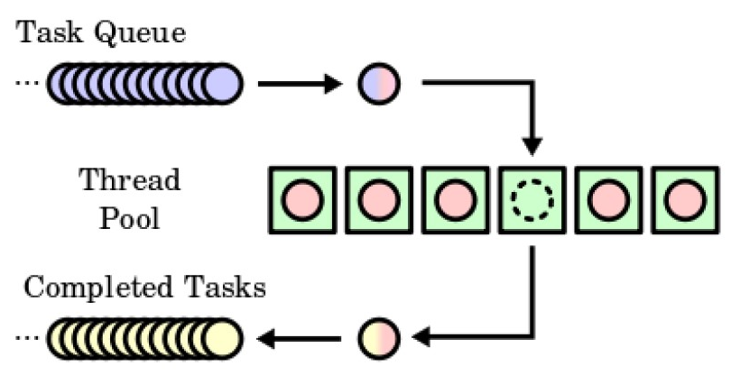
Thread Pool
Thread objects increase the calculation speed on backend process.
Create a pool to hold the threads ready for task taking which can save the expensive process on creating and destroying the thread objects.
Organize the user requests in a task queue.
Work as the teller counter to serve customers in a bank.
When a thread completes a task, it will return back to the pool and ready to serve for the next task.
The number of threads being used in the pool can become a parameter for administrators to configure.
Some servers use CPU size (Megabyte or Gigabytes) as the parameter unit.

Slide 11
With and without Pooling
Without pooling
With pooling
User request comes;
Create a thread object;
Thread processes the request;
Destroy the thread object;
Back to 1.
Creating and destroying thread object are consuming resource.
It doesn’t have the queuing system to hold the waiting requests. If the number of requests are more than the created thread objects, it may lose the timeout requests.
Web container starts and creates a number of thread objects;
Thread objects stay in a pool and wait for user requests;
User request comes;
Assign an idle thread to process the request;
Thread returns back to the pool;
Back to 3;
Web container stops and destroys all the thread objects.
Provide a queuing system to hold the waiting requests.

Slide 12
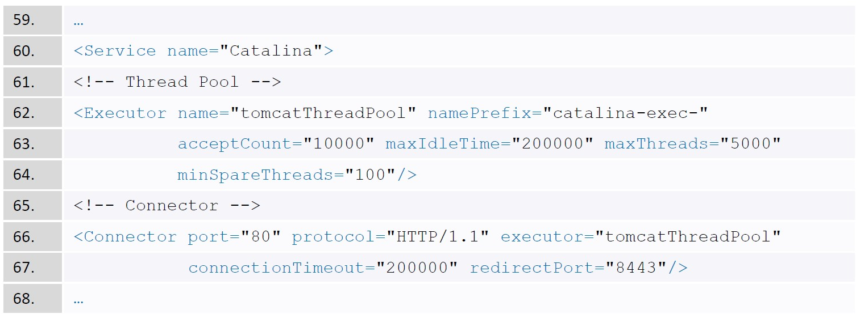
Thread Pool Example
Create a thread pool in side the server.xml file.
Each thread will reserve a region of memory, and beware of memory leak.
The unit for time is millisecond (0.001 second).

Slide 13
Thread Pool in Tomcat
name–for other place in the server.xmlto reference the current pool, name must be unique.
maxThreads–The maximum active number of threads in this pool, default is 200.
minSpareThreads–The minimum number of threads always keep alive, default is 25.
maxIdleTime–The number of milliseconds before an idle thread shutdowns, default is 60,000 (60,000 millisecond = 1 minute).
maxQueueSize–The maximum number of runnable tasks that can queue up awaiting execution before we reject them. Default value is Integer.MAX_VALUE.
More information on tomcat’s thread pool:
http://tomcat.apache.org/tomcat-9.0-doc/config/executor.html

Slide 14
Server Clustering

Slide 15
Technical Terms
Clustering
A cluster is made up of two or more server software instances running on one or more server computers that work together to transparently serve client requests.
Clients perceive the group as a single highly available service.
There are mainly two types of clustering (vertical and horizontal).
Replicate
Any state information is copied verbatim to two or more server software instances in the cluster to facilitate fault tolerance and distributed operation.
Usually, stateful services that are distributed must replicate client session state across the server software instances in the cluster.

Slide 16
Technical Terms (cont.)
Load Balancing (LB)
When a request is made to a distributed service and the server instance that received the request is too busy to serve it in a reasonable amount of time, another server instance may not be as busy.
A load-balanced service is able to forward the request to a less busy server instance within the cluster to be served. Load balancing can distribute the request-processing load to take advantage of all available computing resources.
Sticky Session
Allows the load balancer consistently route the user’s request to the same application instance.

Slide 17
Technical Terms (cont.)
Failover
When one server (software or hardware) suffers a fault and cannot continue to serve requests, clients are dynamically switched over to another server that can take over where the failed server left off.
High Availability (HA)
A service that is always up, always available, always serving requests, and can serve an unusually large volume of requests concurrently is said to be highly available.
A highly available service must be fault tolerant, or else it will eventually fail to be available due to hardware or software failures.

Slide 18
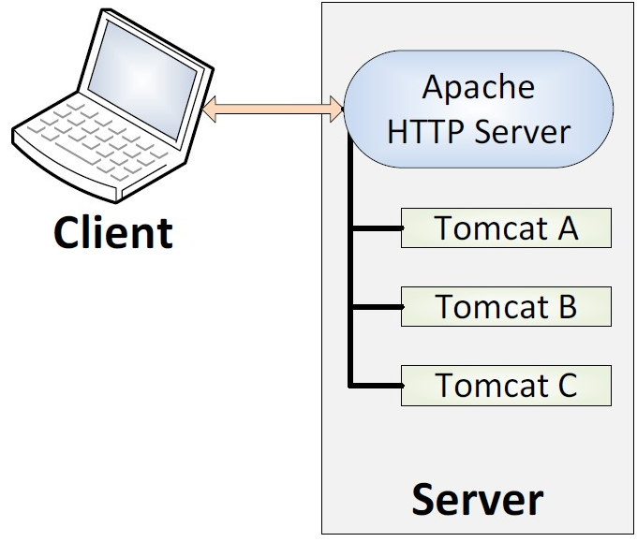
Vertical Clustering
Consists of a single hardware with multiple instances running, using shared resources (CPU, RAM, SPACE, etc.) from the system.
Advantages
Hardware is shared by different application server instances (Tomcat);
Addition of physical hardware is not required;
Single JVM can shared by multiple instances;
No network bandwidth issue.
Disadvantages
High cost (using High-end hardware);
No failover in case of hardware issues;
More maintenance issues (each instance has a different set of configuration).
MPSS -Multiple Ports Single System. Three tomcat instances with the same IP address but different port numbers.

Slide 19
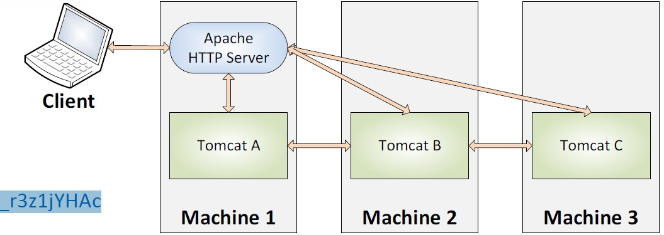
Horizontal Clustering
Application server instances (Tomcat) are configured separately on each physical machine with high speed network.
Advantages
Failover is possible in the case of hardware failure;
A low-end system can be used as a single instance runs for each instance;
Low maintenance issues (each instance can use the same set of configuration).
Disadvantages
Network bandwidth issues between machines;
Require more physical hardware.
Rasberry Pi Project
https://www.youtube.com/watch?v=i_r3z1jYHAc

Slide 20
Load Balancer Mechanism
Assign each server instance a number (from 1 to n) for calculation.
Methods for forwarding the requests to an instance:
Round Robin: sequentially from 1 to n.
Hash source (sticky session): hash users information (IP address, user ID, session ID, access time, etc.) to find the server number.
Least Connection: always forward to the least connection server instance.
Random: randomly pick a number from 1 to n.
Rating / Priority: server has higher priority when it has more resources (CPU, RAM, space, bandwidth, etc.).

Slide 21
LB Configuration Procedures
Install JDK, Apache HTTP and Tomcat Servers
Configure Apache HTTP Server
httpd.conf(JK module, mount context, etc.)
workers.properties(tomcat instances)
Configure Tomcat Server
server.xml (Shutdown Port, Connector Port, Apache Jserv Protocol (AJP) Port, etc.)
For more information:
O’Reilly -Tomcat The Definition Guide

Slide 22
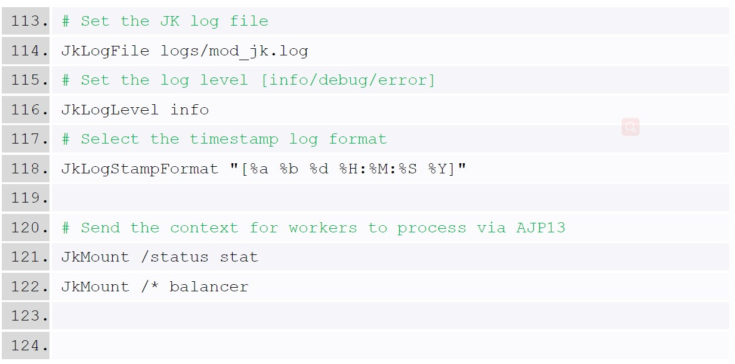
Apache HTTP Server Configuration
Edit the httpd.conf file to load the JK module and specify the location of workers.properties.

Slide 23
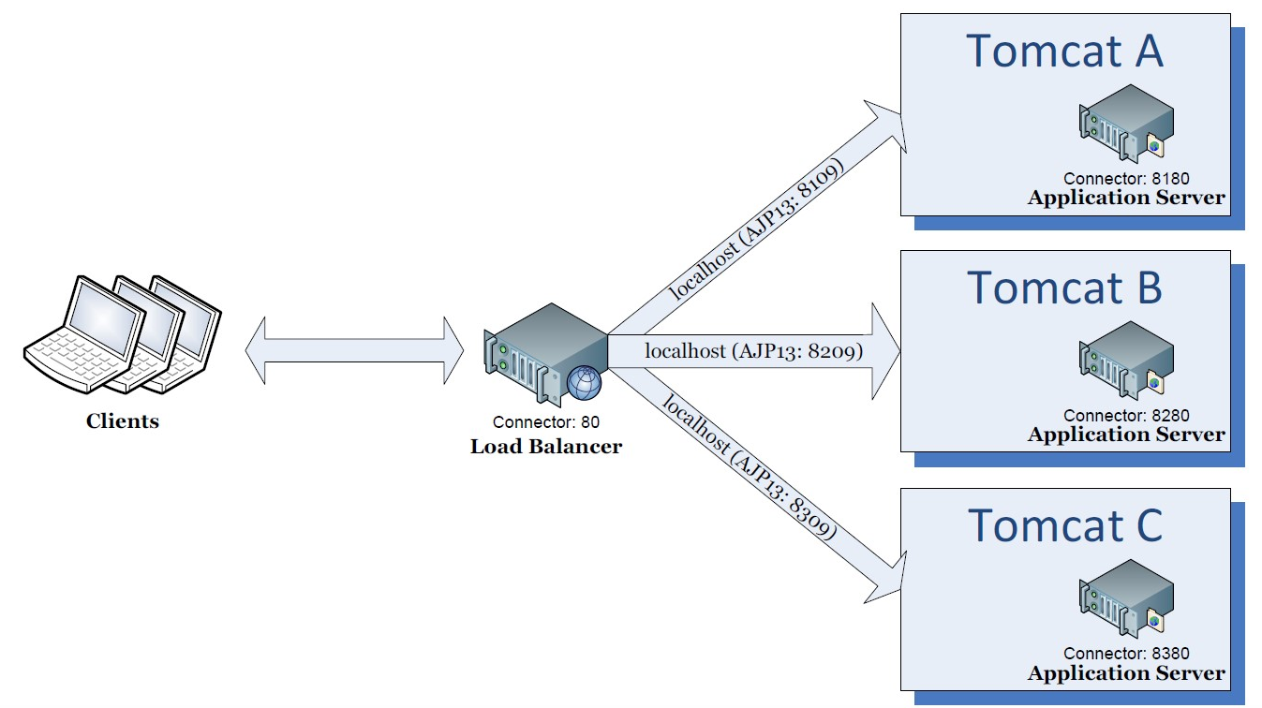
Case 1: Logical Diagram (Vertical)
A load balancer to control 3 tomcat instances.

Slide 24
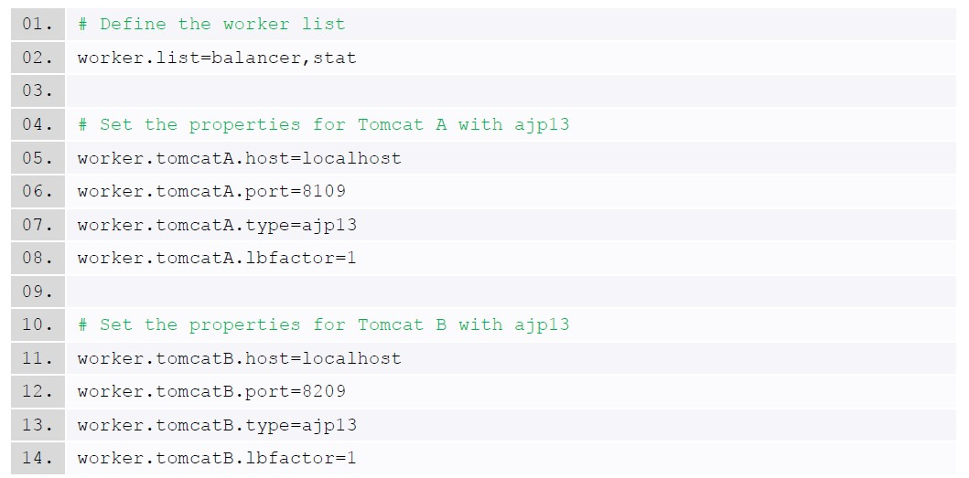
workers.propertiesfor Vertical Clustering
Set up three tomcat instances.

Slide 25
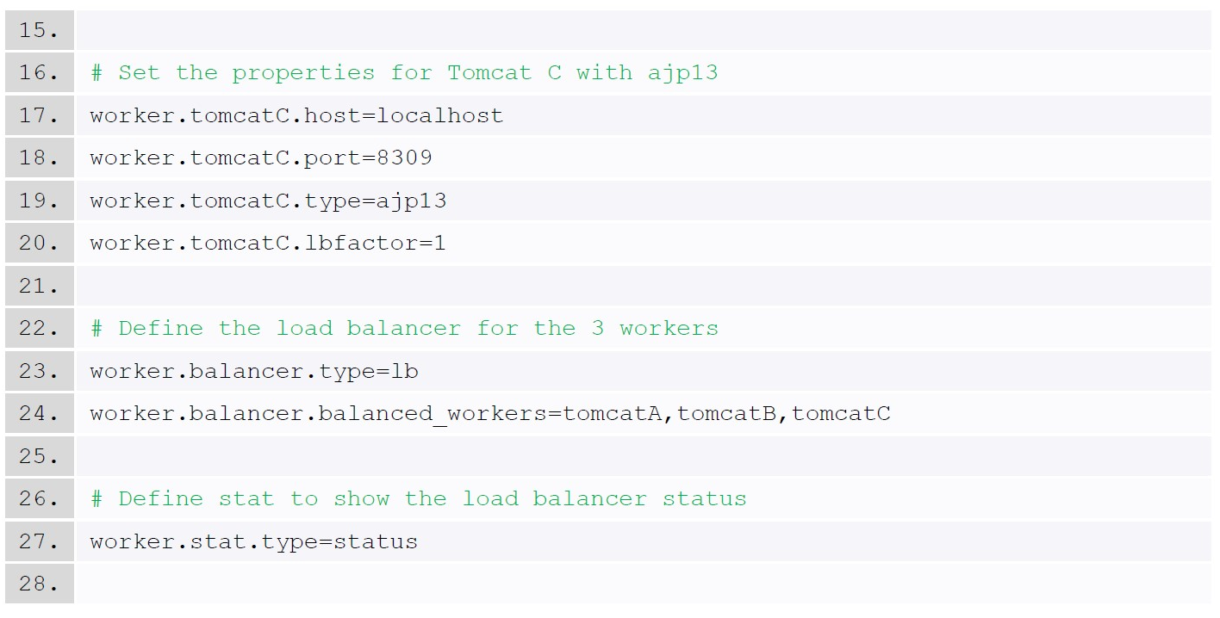
workers.propertiesfor Vertical Clustering (cont.)
Define a load balancer with three workers.

Slide 26
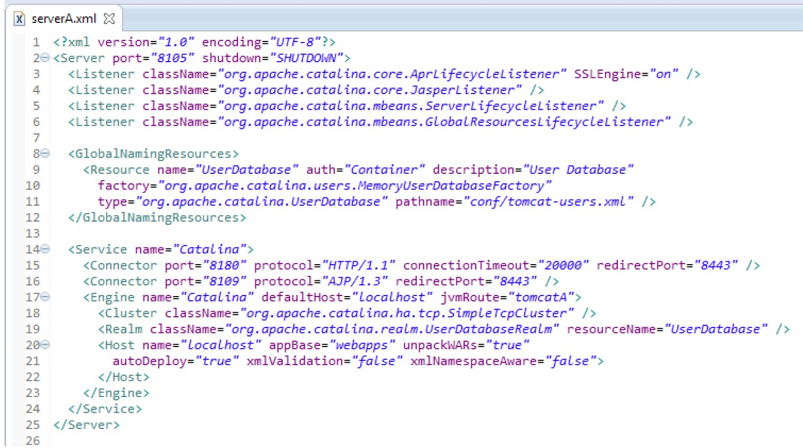
Vertical Clustering Configuration
Application instance: Tomcat A

Slide 27
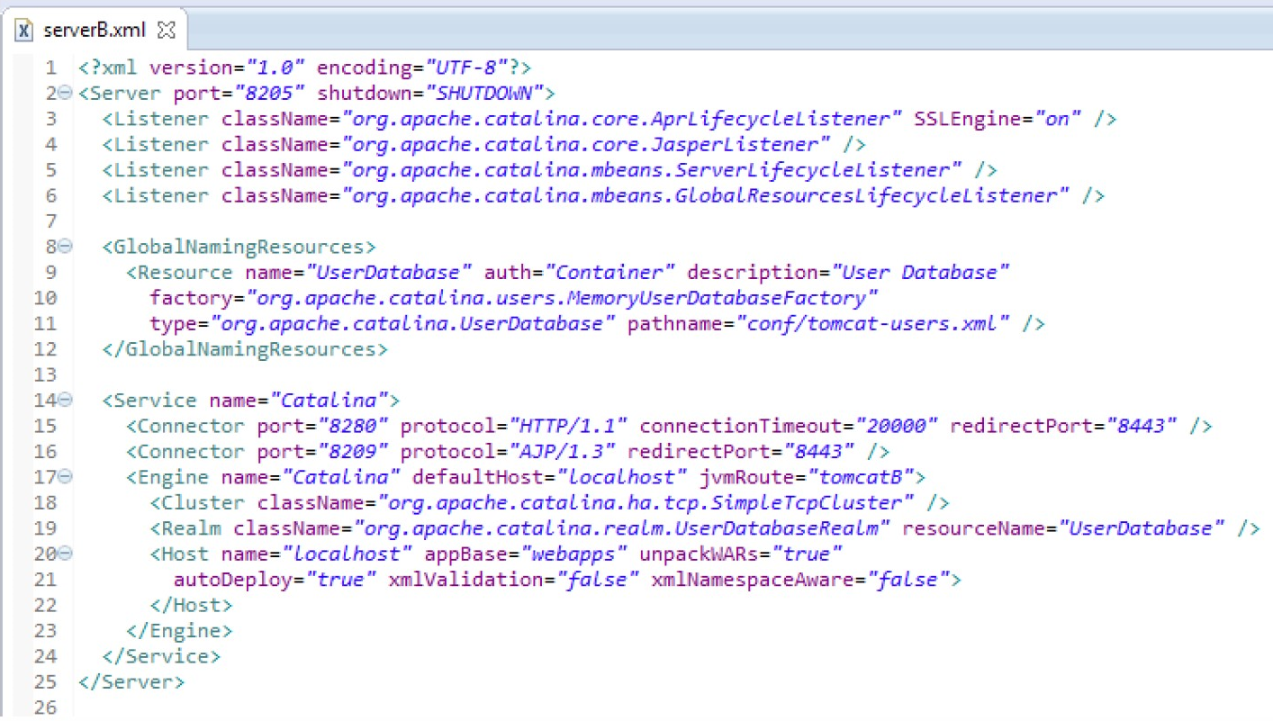
Vertical Clustering Configuration
Application instance: Tomcat B

Slide 28
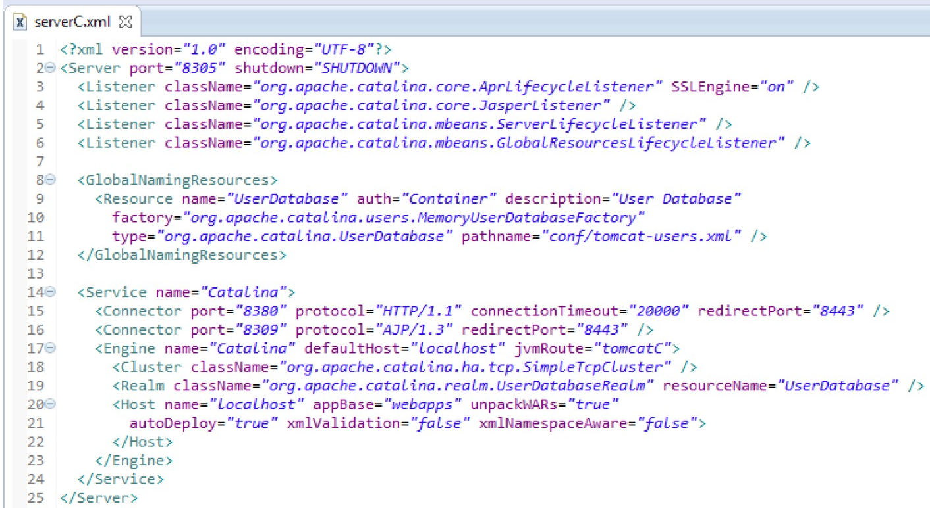
Vertical Clustering Configuration
Application instance: Tomcat C

Slide 29
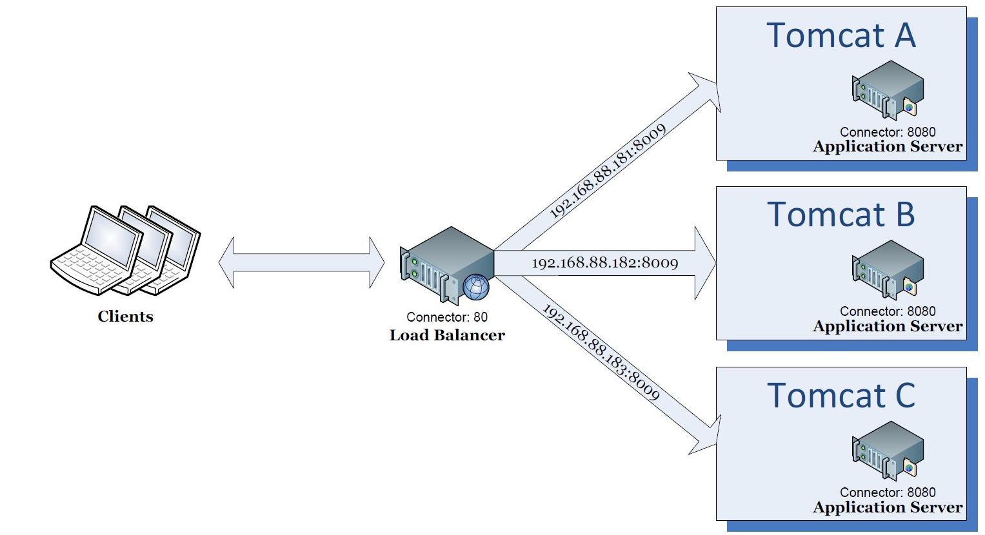
Case 2: Logical Diagram (Horizontal)
A load balancer to control 3 tomcat instances.

Slide 30
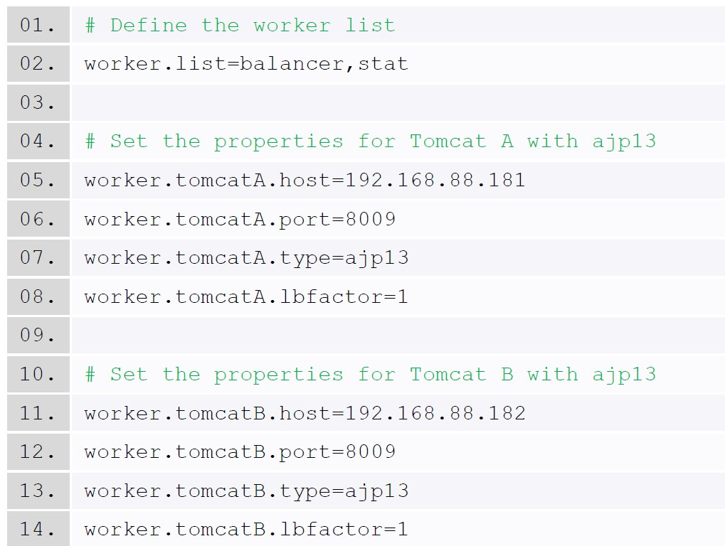
workers.propertiesfor Horizontal Clustering
Set up three tomcat instances.

Slide 31
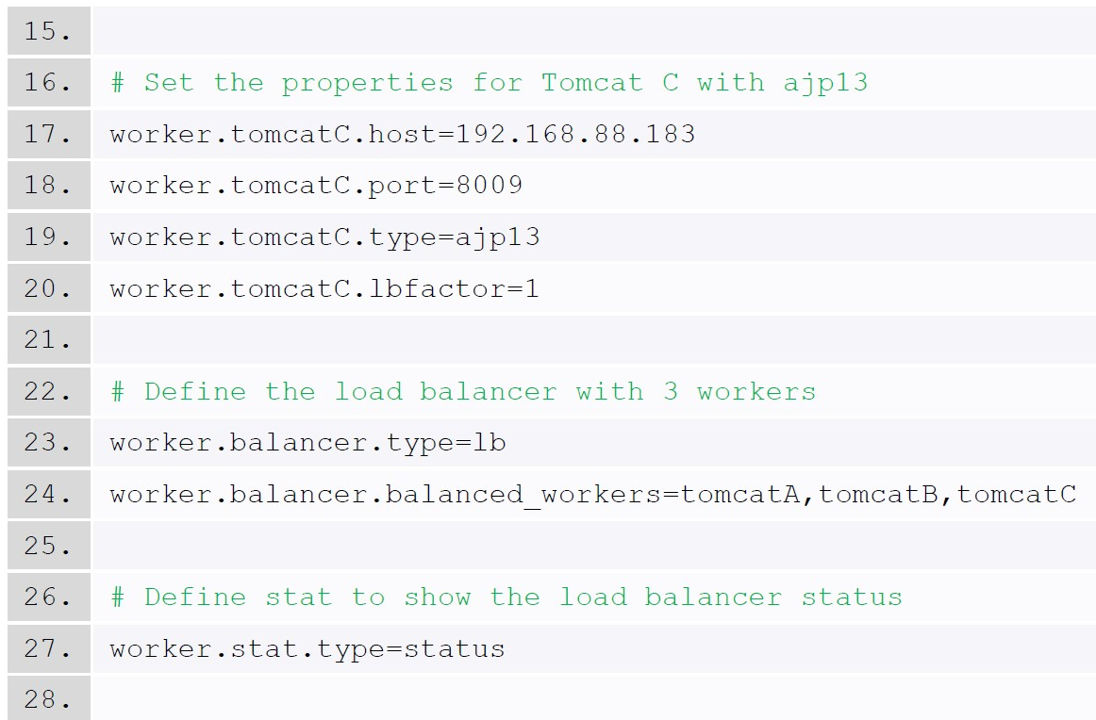
workers.propertiesfor Horizontal Clustering (cont.)
Define a load balancer
with three workers.

Slide 32
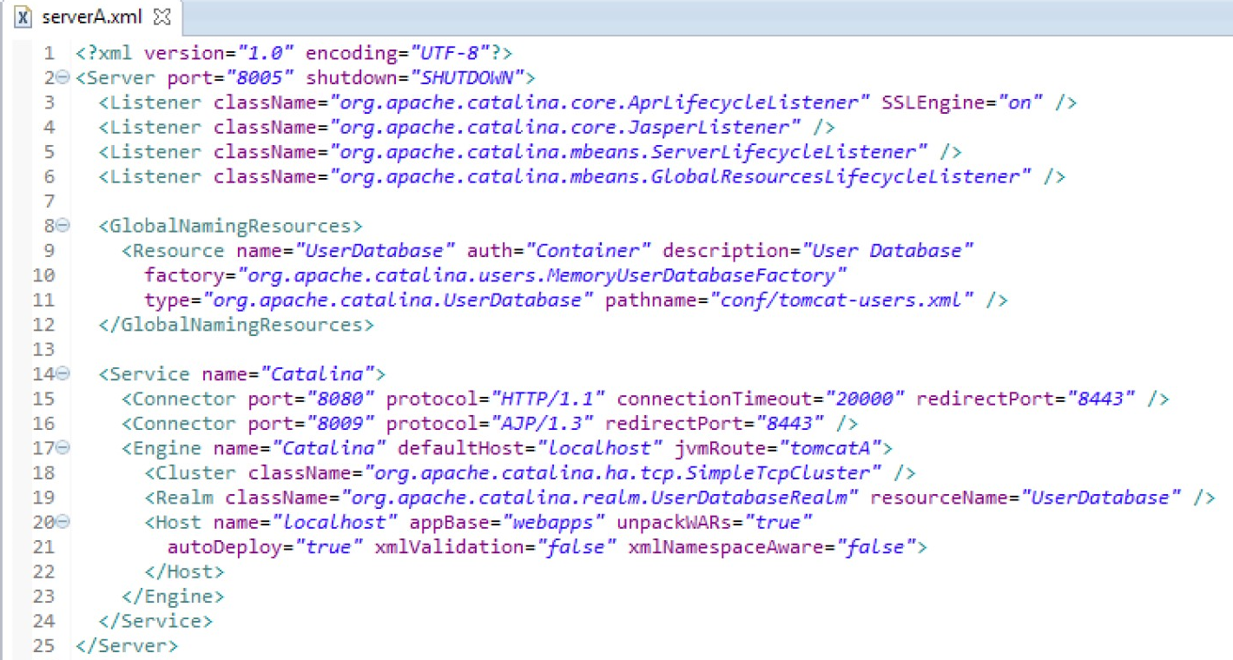
Horizontal Clustering Configuration
All instances use the same set of configuration (Shutdown: 8005, Connector: 8080, AJP: 8009).

Slide 33
Server Management Example
Optimize the server resource to allow your program to run beyond the default limits.
Utilize the server resource effectively can reduce the chances of server crash down and can provide higher quality of services.
Modify the resource setting:
Thread Pool (CPU), Heap Size(Memory), Connection Pool (Database Connection), log files (Disk Space), Cache, etc.
The configuration on different application servers will not be the same but the ideas are similar
Set up multiple application instances for High Availability (HA) service.
Some modern application servers provide user interfaces for easier configuration but those setting are eventually stored into XML files.
Apache Tomcat (server.xml, context.xml, etc.)
IBM WebSphere provides elegant user interfaces

